Slide 1
Development of a training programme for the safe use of drones in industrial applications

Slide 2
Current ECITB training
ECITB have previously developed a training standard for ‘Industrial Drone Operations’ (IDO) released in 2017
The IDO training standard required review after legislative changes and technological advances in UAS systems, controls and payloads
Whilst the current standard is largely applicable, the removal of the PfCO and introduction of the GVC are some of the changes being addressed
Engineering Construction Industry (ECI) has seen a dramatic increase in the utilising of UAS due to flexibility, reduction in disruption to production and obvious safety advantages, this has meant the interest from the ECI has increased significantly and raised specific issues
This has left the ECI with the requirement to either train their own operatives or understand the requirements of their inspection scope when subcontracting the inspections; in a rapidly changing technological environment this no small task
ECITB has formed a working group from the ECI and UAS training providers to help update the training standard, and develop additional ones as well as identify how to update our members understanding of the UAS services and capabilities

Slide 3
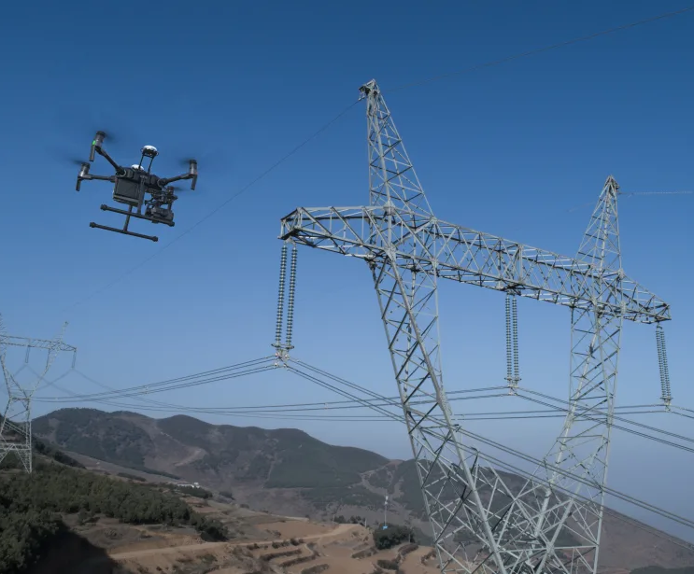
ECITB training standard development
UAS working group has identified;
The assured competence of UAS operators has a direct impact on the operational site and presents unique hazards and safety concerns
The current providers for the inspection services consists a small number of trusted companies, however the expansion in utilisation of UAS has increased the requirement for new operators and further specialisation
There is a general lack of knowledge of the specific site hazards and specifically the hazardous areas, such as Oil & Gas, Nuclear etc
Image courtesy of DJI

Slide 4
ECITB training standard development
UAS working group has identified;
The recovery of an error at low attitudes where UAS are utilised leaves little time for recovery by the operator and understanding how to respond if the failure occurs has a direct impact on the operational site, recent incidents have highlighted the need for training to fly without positional assitance
Existing client site teams greater knowledge of the site safety and operational requirements does not mean they can operate a UAS successfully
UAS operators limited knowledge of the site entry requirements such as basic safety courses and specialist vetting requirements or even off shore survival training; simply put UAS operators don’t know what they need to know and how to meet the requirements before accessing the site
Image courtesy of DJI

Slide 5
How the ECITB training standards increase safety
The training standards provide the following;
Content which must be covered for a specific industrial sector, examples included nuclear, petrochemical, pharmaceutical, water treatment, oil and gas and renewables including off shore wind
Technical tests to confirm a consistent level of knowledge and practical demonstration which will be certificated
A wider scope of content and of depth agreed by the working group with the ECI
Nationally recognised standards which the ECI can benchmark against
Quality assured training providers monitored by the ECITB QA team
Training for ECI personnel to understand the UAS operations and how it will meet their inspection scope: the intelligent customer
Re-training to combat skill fade, perishable skills and deskilling with automated systems

Slide 6
Blade inspection of wind turbine
Image courtesy of DJI

Slide 7
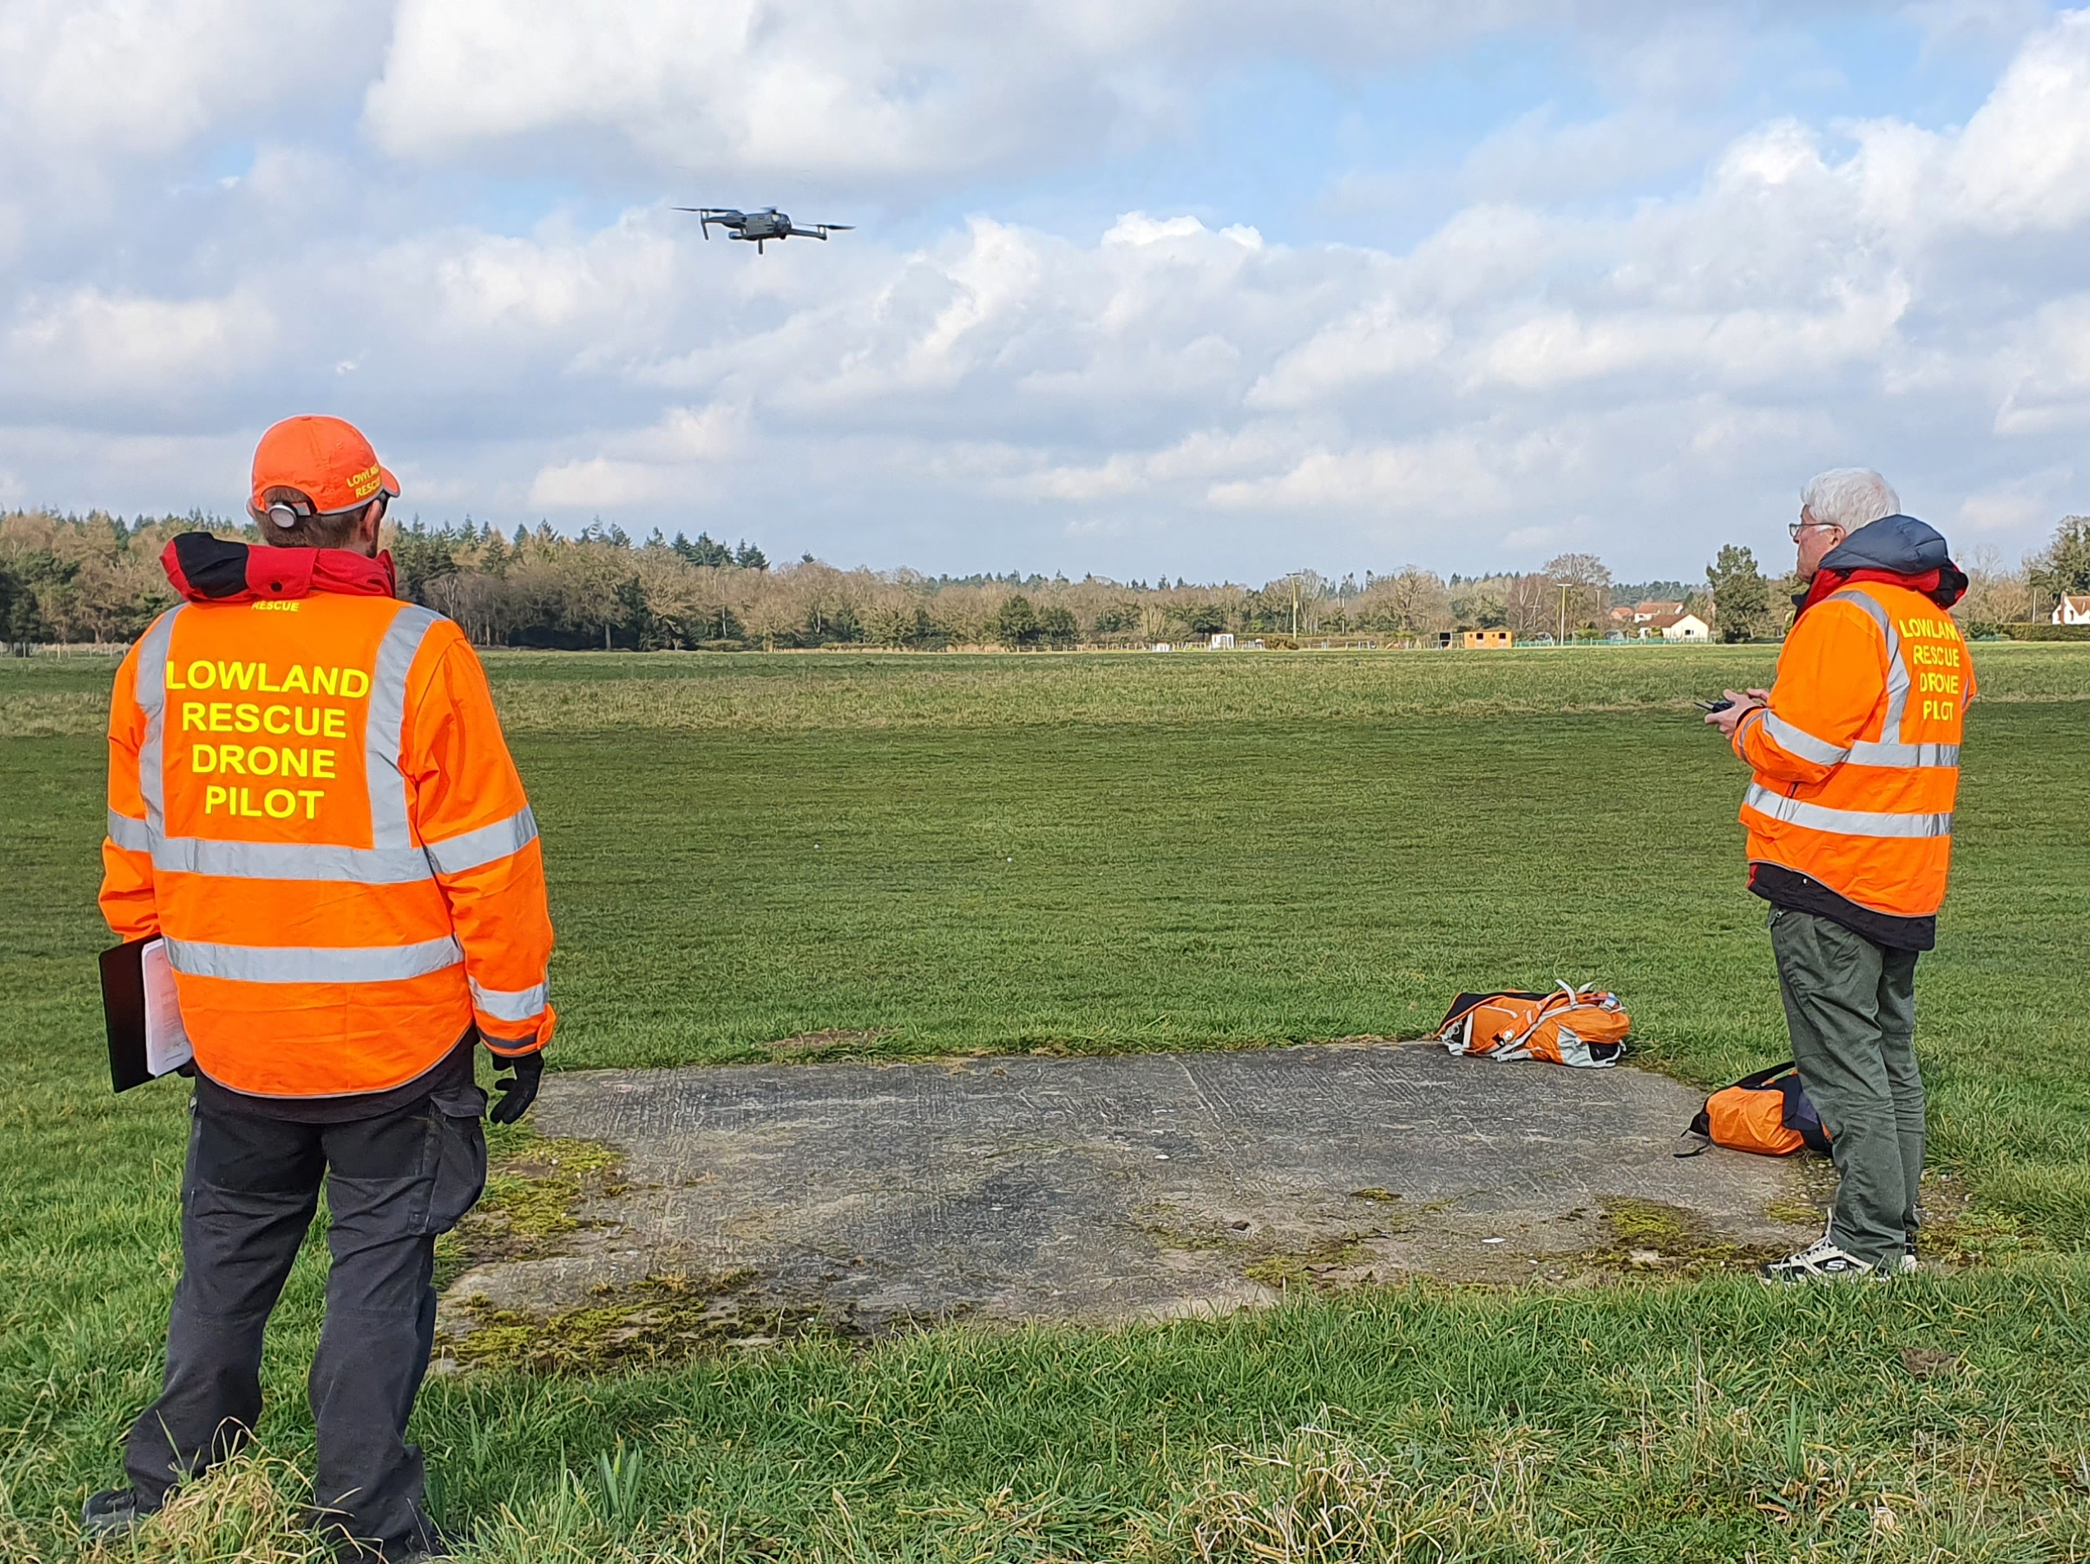
Why is ECITB involved in UAS training
The training standards development by the ECITB;
Government mandate to ensure the training is undertaken providing the skills for the future, increases productivity and competitiveness
Nationally recognised standards of competence in UAS
Quality assured training programme
The ECITB equips our industry with the right skills to harness new technologies to improve safety and productivity
We work with employers, training providers and Government to ensure the engineering construction workforce has the skills for Industry 4.0 and for net zero energy jobs in the future
ECITB is the training board for the Engineering Construction Industry
Image courtesy of dronetraining.co.uk

Slide 8
How do we develop the Training standard
The training standards are development by the ECITB utilising;
National and international standards
Consultation with the ECI as well as UAS operators and training institutions (working group)
Form a working group and utilise consultation and cooperation
Specifically consider UAS operations on ECI sites and operations
Focus on site interaction not ariel interaction
Describe what competence looks like and how it can be maintained
Equip the ECI with the information and training to ensure they are aware of the implications of UAS operations onsite

Slide 9
How do we assess knowledge and the practical application
The online portal ECITB utilises allow us to;
Maintain the standard of the testing in real time
Adapt to changes in practices and technology
Ensure consistent questioning/activities are across all our Approved Training Providers (ATPs)
Monitor pass/refer rates and ATPs
Set guidelines for the tests, including documentation and facilities
Quality assure the process
Verification of the certification including identification of the candidate
This Photo by Unknown Author is licensed under CC BY-SA-NC

Slide 10
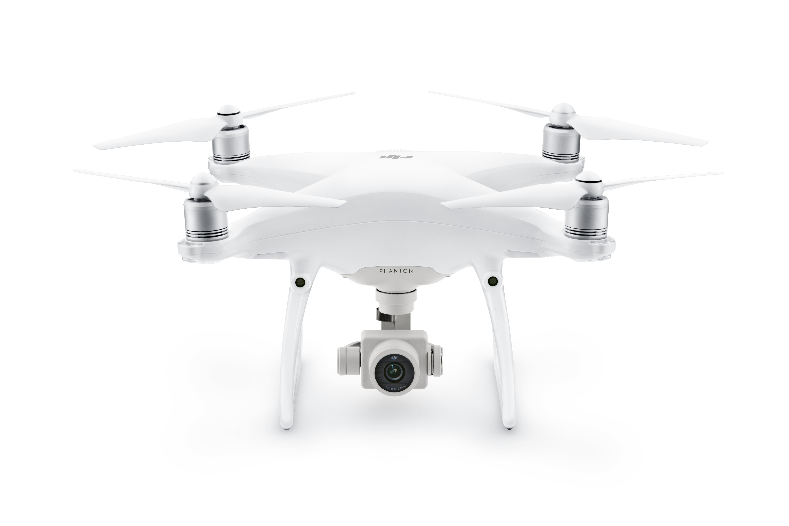
Thank you for listening
Image courtesy of DJI

